Slide 2
What's new in the Microsoft Bot Framework v4
Stephan Bisser
THR3159

Slide 3





Stephan Bisser Microsoft MVP (AI) https://www.cloudguy.pro @cloudguy_pro #AskCloudguy Graz, Austria
http://bit.ly/LEARN_TO_BOT

Slide 4
Bot Framework by the numbers
10,000,000+ messages/day
1,000,000+ unique users/day
300,000+ developers
10,000+ active bots
800K+ SDK Downloads
1000+ companies

Slide 5
Bot Framework V4
GA - C# and Java Script
C# support .NET Core
Python and Java - still in preview
Incorporates learnings from V3
Open, Modular and extensible architecture
Agile and customizable dialog system
Share the same implementation across C#, Java Script, Java and Python
Rich visual controls (cards, buttons, images, videos, adaptive cards)
Seamless integration with Azure and Cognitive Services
Modern toolchain (streamline development and deployment)
Open Source and rich ecosystem

Slide 6
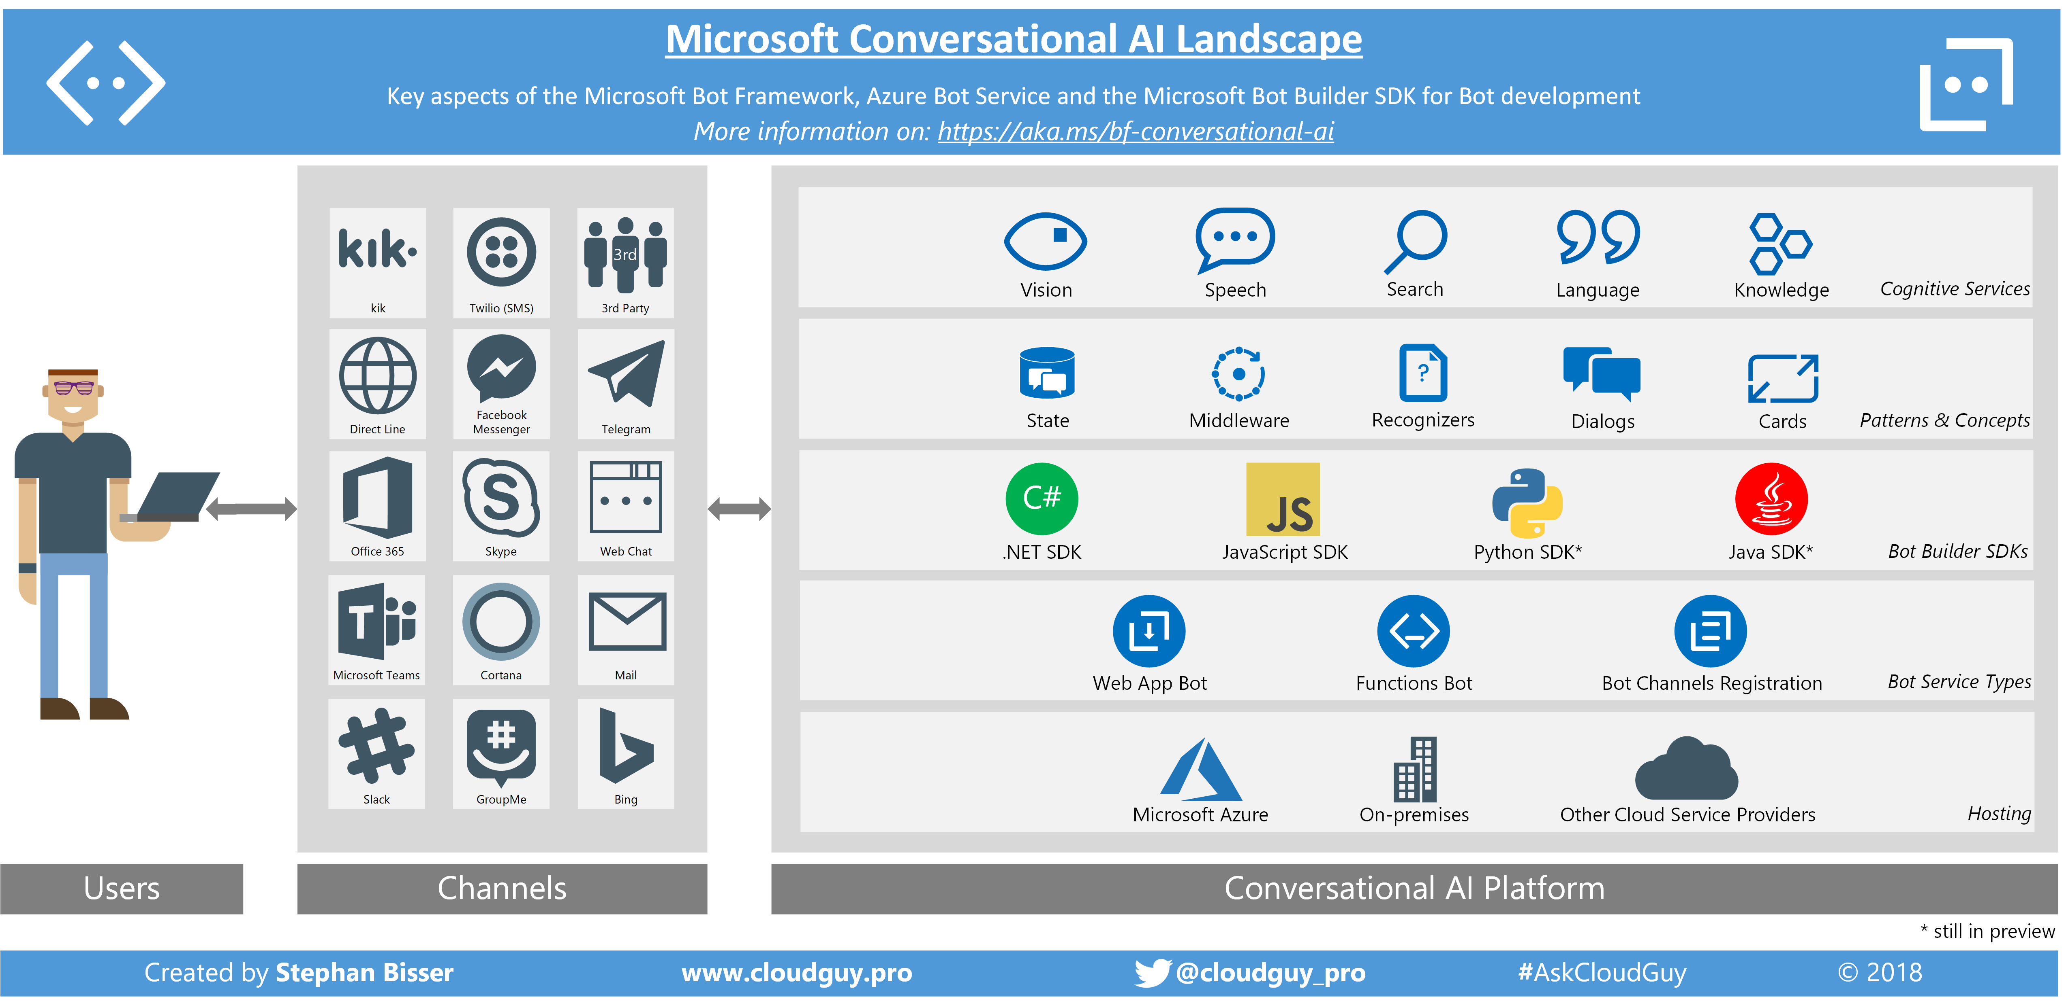

Slide 7
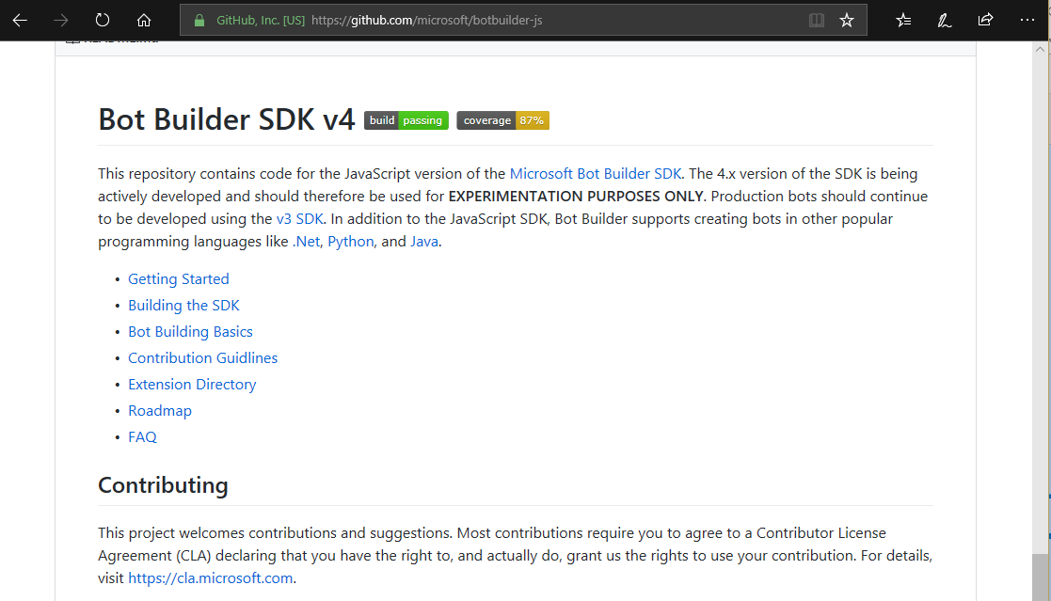
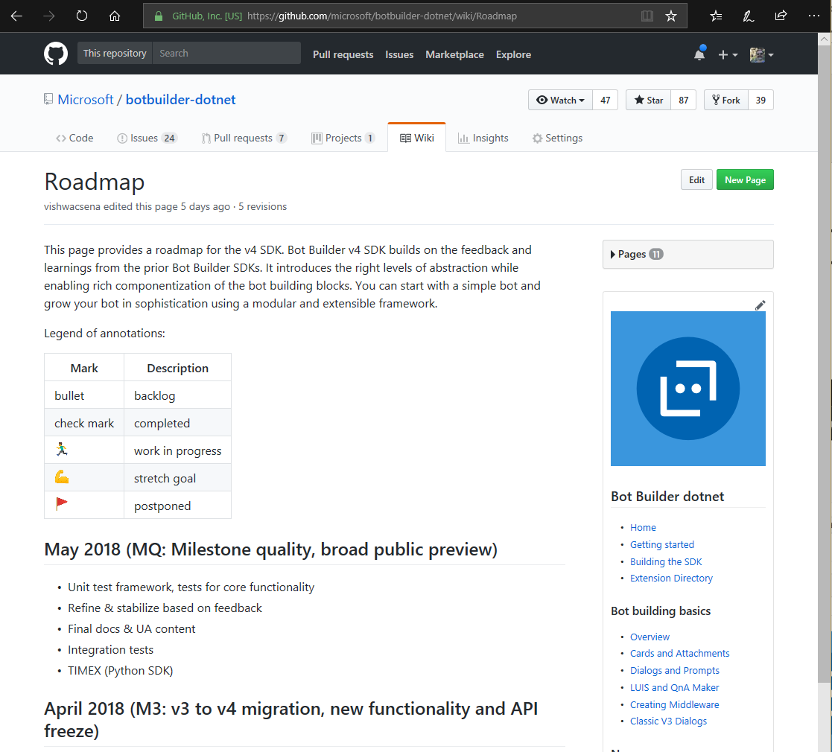
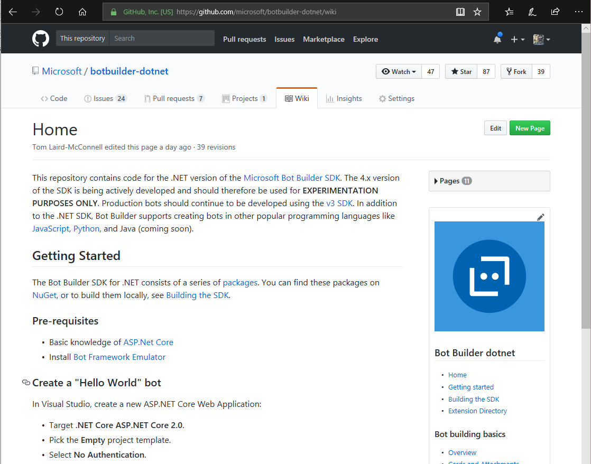

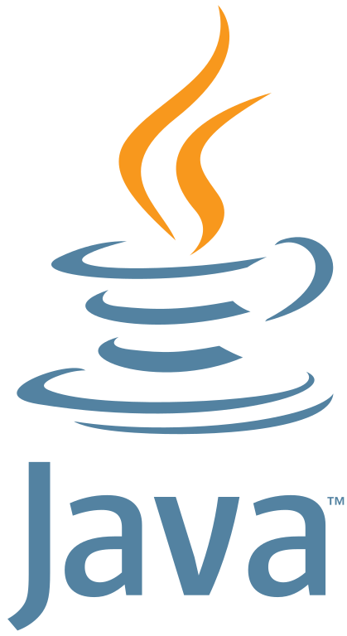



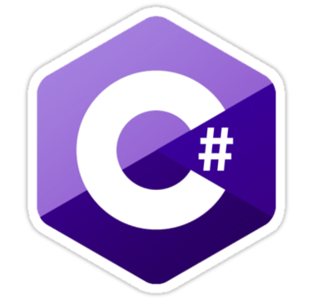
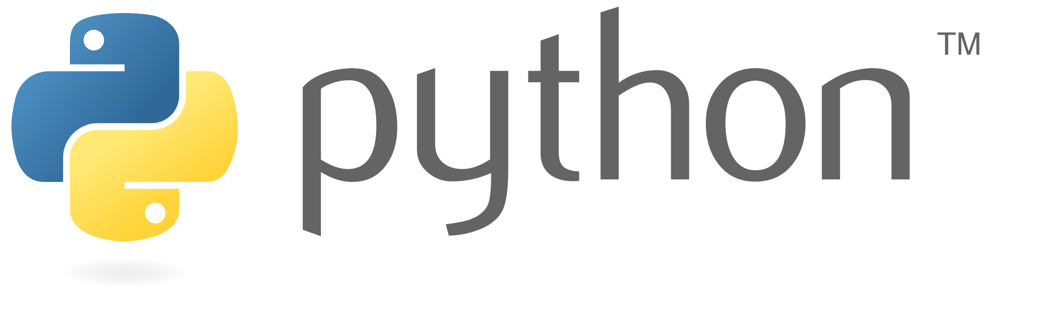
Bot Framework – Open Source Project
10 Public Repos
By developers for developers
300K+ Developers
800K+ SDK Downloads
Open Source
Community Engagement
Thriving Ecosystem
SDK V4: C#, JavaScript, Python, Java
SDK V3 (C#, JavaScript)
CLI Tools
Emulator
WebChat Control
Documentation
BotBuilder-Samples
10+ Public Repos
SDK V4: C#, JavaScript, Python, Java
SDK V3 (C#, JavaScript)
CLI Tools
Emulator
WebChat Control
Documentation
BotBuilder-Samples (more than 60 samples…)
Notes:
https://azure.microsoft.com/en-us/blog/build-conversational-experiences-with-microsoft-bot-framework/
https://blog.botframework.com/2018/11/06/announcing-bot-framework-sdk-and-tools-4-1-release/

Slide 8
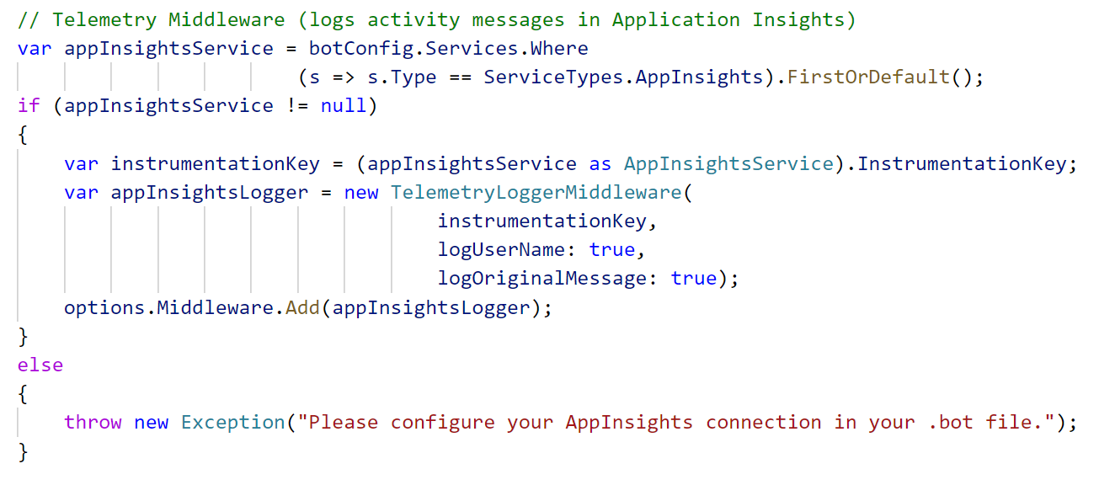
SDK Extensibility through Middleware
Uniform concept across platforms
Annotating / processing / transforming activities
Adding Telemetry (App Insights) middleware
Standard Middleware Calling Pattern
Request
Middleware 1
// logic
Next();
//more logic
Middleware 2
// logic
//more logic
Response
Find this sample on https://github.com/Microsoft/BotBuilder-Samples

Slide 9
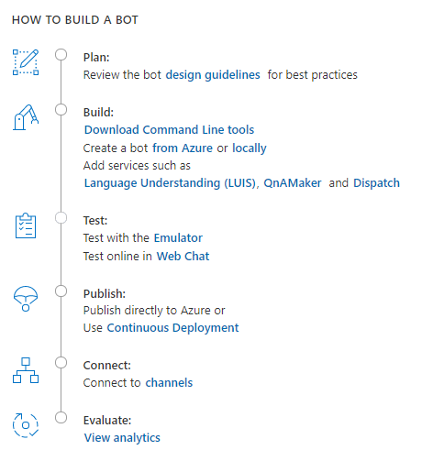
How to build a bot
Plan
Build
Test
Publish
Connect
Evaluate

Slide 10
The Lifecycle of your Project
Comprehensive framework for the lifecycle of your project
Plan
Build
Test
Publish
Connect
Evaluate
Author Dialogs
Design Cards
Visualize
Bot Builder SDK
Cognitive Services
Getting Started Templates
Emulator​
Application Insights
Conversation Transcripts
DevOps Tools
Azure
BYO Web Host
WebChat
Cortana
Skype, FB
+
Custom (DirectLine)
Application Insights
LUIS Suggestions

Slide 11
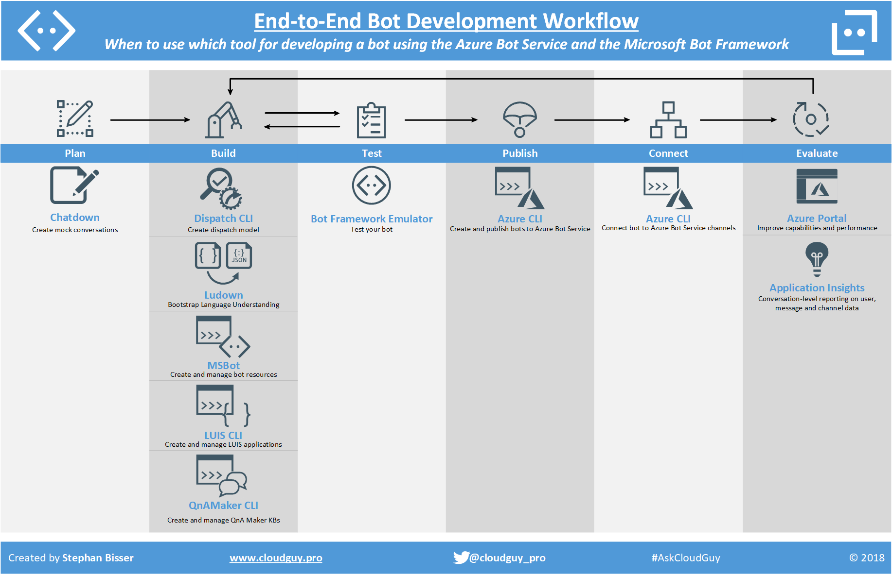

Slide 12
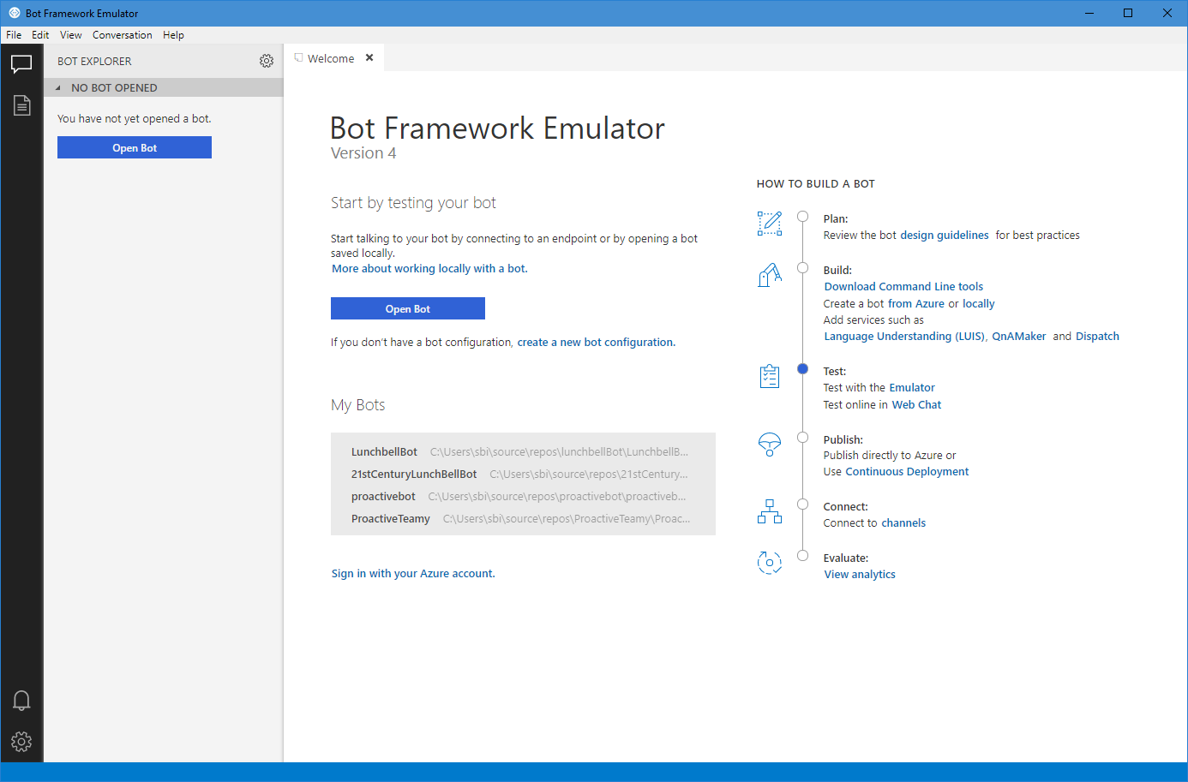
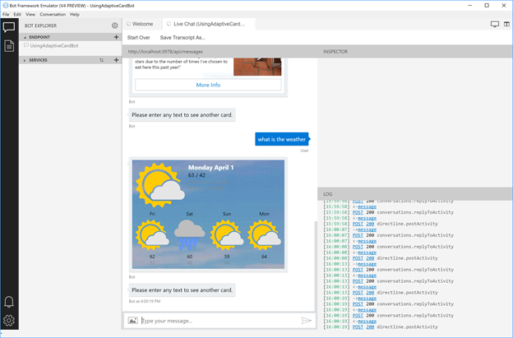
Bot Framework Emulator V4
Open-source, cross-platform application
For Mac, Windows and Linux
Test and debug conversational application locally or in the cloud
Inspect responses from bot’s integrated services (LUIS/QnAMaker)
Transcript playback

Slide 13
Templates and Solutions
Templates
• Basic
• Enterprise
Solutions
• Virtual Assistant
• Customer Support (Coming Soon)
To help more businesses and customers succeed with great conversational experiences, we are creating a series of Templates to greatly simplify getting started and Solutions to help enable complex new scenarios.
Bringing together all of the best practices and supporting components we've identified through building the first wave of Conversational Experiences.

Slide 14
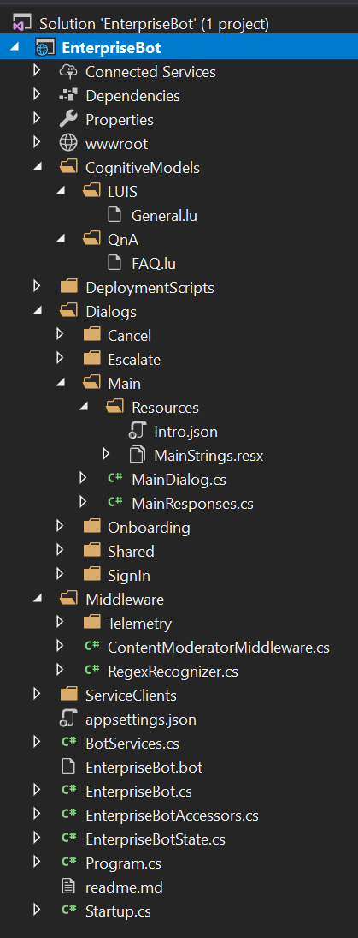
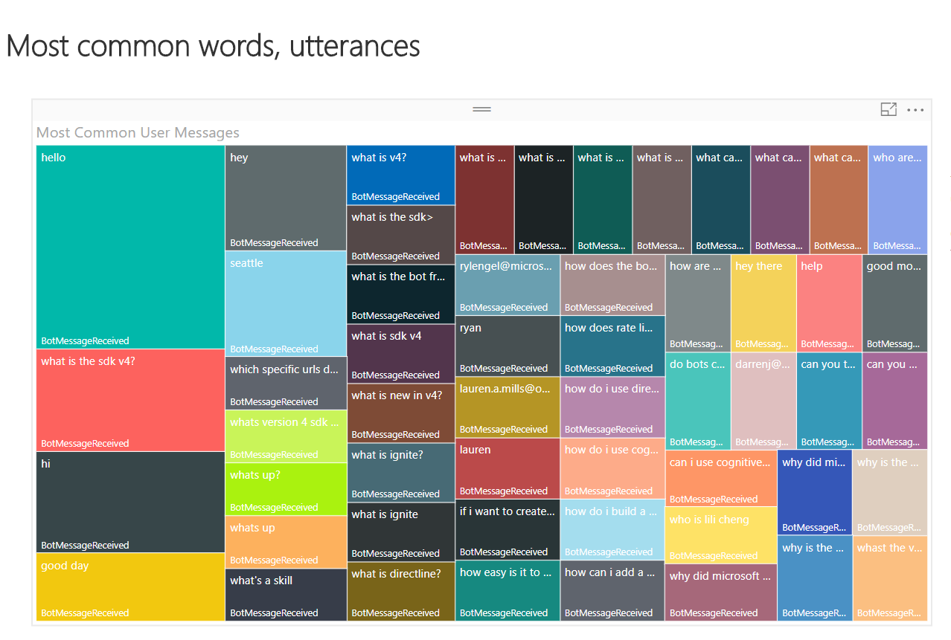
Templates and Solutions
5 minutes to a working end-to-end conversational experience
Introduction message with Adaptive Cards
Automated typing indicators
.bot file driven configuration
Example Dialogs
Basic conversational intents in multiple languages
Example responses abstracted into separate View classes.
Inappropriate / PII detection with Content Moderator
Transcripts of all conversations stored in Azure Storage
QnAMaker Integration
Integrated Dispatcher for LUIS and QnA targets
Application Insights and PowerBI for Conversation Analytics
Authentication
Complete automated deployment of all aspects
Open Sourced and updated regularly.

Slide 15
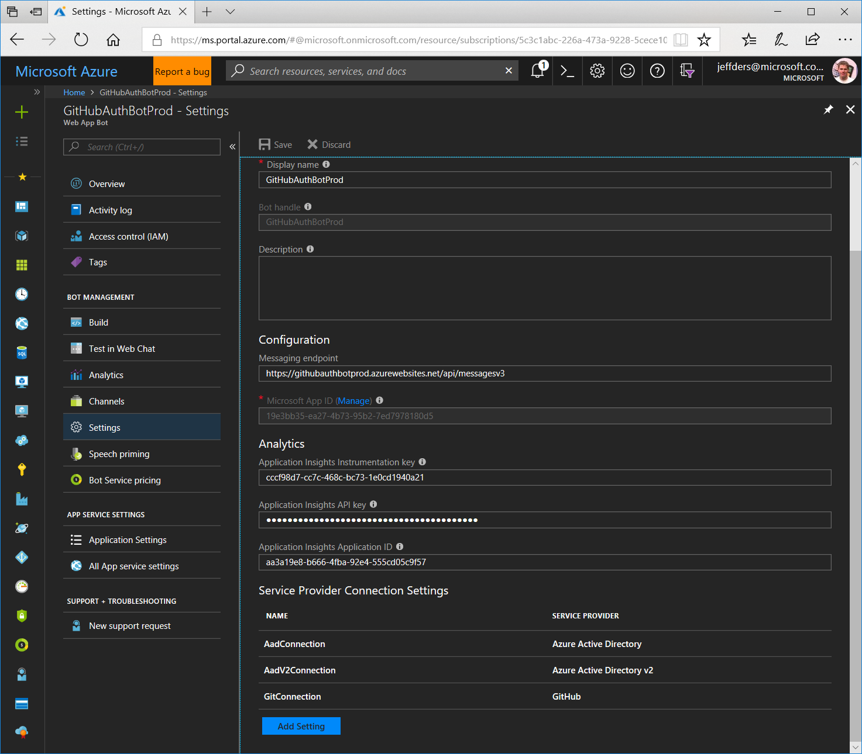
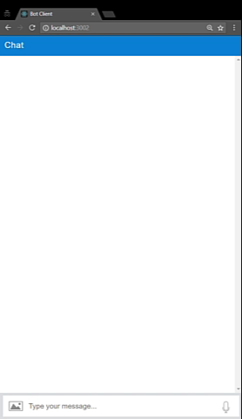
Authentication
Configure OAuth in Azure
Use OAuth in your Bot

Slide 16













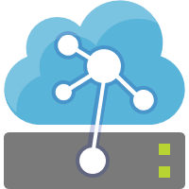


Channels
Virtual Assistant
Your brand, your assistant
Knowledge
Sources
General Knowledge
Manuals (PDF)
AI Capabilities
Data Sources
Azure Bot
Services
Conversation Skills (Customisable)
User
Input
Speech
Virtual Assistant
Your Brand
Your Personality
Dialogs
Language Model
Mail
Tasks
Tap
Adaptive Cards
Point of
Interest
Calendar
Linked
Accounts
Automotive
Hospitality
Type
Speak
QnA
Vision
Custom
Language Understanding
Devices
3rd Party
Assistants
APIs
Productivity
1st/3rd Party
IoT Edge
Directory

Slide 17
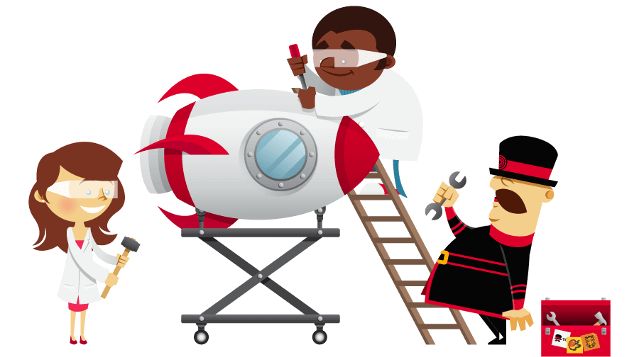
yo botbuilder – Yeoman Generator
md myJsBots
cd myJsBots
npm install -g npm
npm install -g yo generator-botbuilder
yo botbuilder
npm start

Slide 18
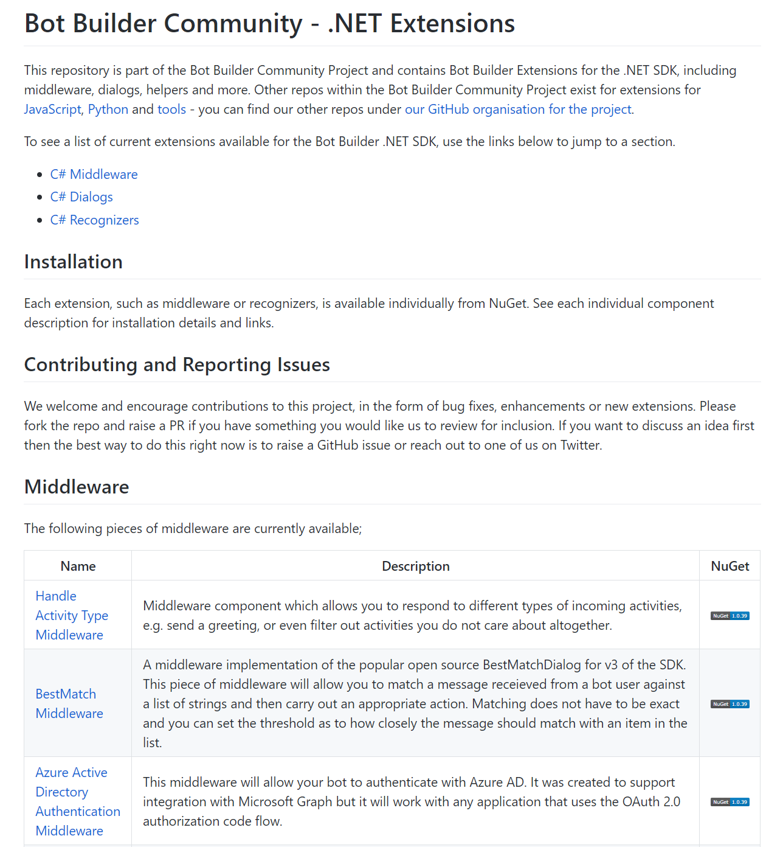
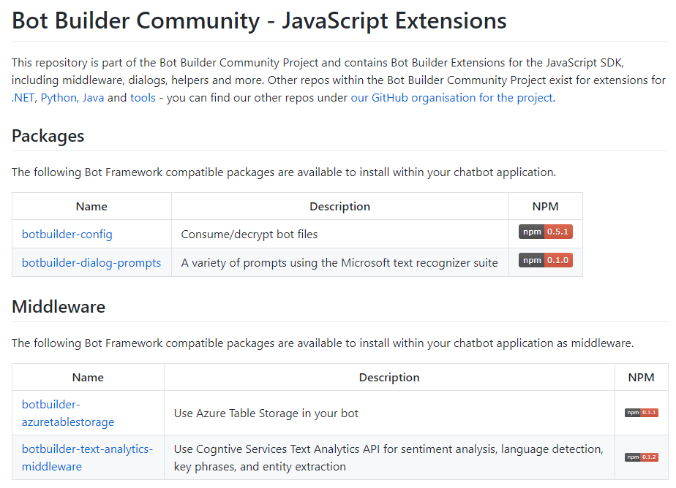
Community Driven Bot Extensions
https://github.com/BotBuilderCommunity
Extending the core Bot Framework SDKs
Middleware, dialogs, helper
Gary Pretty (https://github.com/garypretty)
James Mann (https://github.com/jamesemann)
Arafat Tehsin (https://github.com/arafattehsin)
Michael Szul (https://github.com/szul)
Stephan Bisser (https://github.com/cloudguy-pro)

Slide 19
Get Started with V4 Today!
Get started - http://aka.ms/botframeworkdocs
Latest SDK https://github.com/Microsoft/botbuilder
Tools and samples
https://github.com/Microsoft/botbuilder-tools
https://github.com/Microsoft/botbuilder-Samples

